Slide 1
Amazon Redshift
December 2019

Slide 2
Course Content
Introduction
Benefits
Key Features
Columnar Storage
Architecture
Cluster Management
Cluster Instance Types
Data Definition Language
Best Practices
Distribution Style
Sort Key
Compression Encoding
Vacuum and Analyze
Data Loading and Unloading
Stored Procedure

Slide 3
Introduction
Amazon Redshift is a fast, scalable data warehouse that makes it simple and cost-effective to analyze all your data across your data warehouse and data lake.
Redshift delivers 10 times faster performance than other data warehouses by using machine learning (ML), massively parallel query execution and columnar storage on high-performance disk.
Setup and deploy a new data warehouse in minutes, and run queries across petabytes of data in Redshift data warehouse, and exabytes of data in data lake built on Amazon S3.
Start small for just $0.25 per hour and scale to $250 per terabyte per year, less than 1/10th the cost of other solutions.

Slide 4
Benefits
Faster performance: Amazon redshift delivers 10x better performance than other data warehouses.
Easy to set up, deploy, and manage: Amazon redshift is simple to use, deploy a new data warehouse in minutes.
Cost-effective: Amazon redshift is the most cost effective cloud data warehouse, and less than 1/10th the cost of traditional data warehouses on-premises.
Scale quickly: Amazon redshift can scale from querying gigabytes to exabytes of data across redshift data warehouse and amazon s3 data lake.
Query data lake: Amazon redshift extends data warehouse to data lake to help gain unique insights that could not get by querying independent data silos.
Secure: Amazon redshift runs mission critical workloads for large financial services, healthcare, retail, and government organizations.

Slide 5
Key Features
Massively Parallel Processing: MPP enables fast execution of the most complex queries operating on large amounts of data.
Columnar Data Storage: Columnar storage for database tables drastically reduces the overall disk I/O requirements and is an important factor in optimizing analytic query performance.
Data Compression: Data compression reduces storage requirements, thereby reducing disk I/O, which improves query performance.
Query Optimizer: Query optimizer implements significant enhancements and extensions for processing complex analytic queries that often include multi-table joins, subqueries, and aggregation.
Result Caching: Result Caching reduce query execution time and improve system performance, Amazon Redshift caches the results of certain types of queries in memory on the leader node.
Compiled Code: The leader node distributes fully optimized compiled code across all of the nodes of a cluster.

Slide 6
Columnar Storage
Columnar storage for database tables is an important factor in optimizing analytic query performance because it drastically reduces the overall disk I/O requirements and reduces the amount of data you need to load from disk.
Using columnar storage, each data block stores values of a single column for multiple rows. As records enter the system, Amazon Redshift transparently converts the data to columnar storage for each of the columns.
An added advantage is that, since each block holds the same type of data, block data can use a compression scheme selected specifically for the column data type, further reducing disk space and I/O.

Slide 7
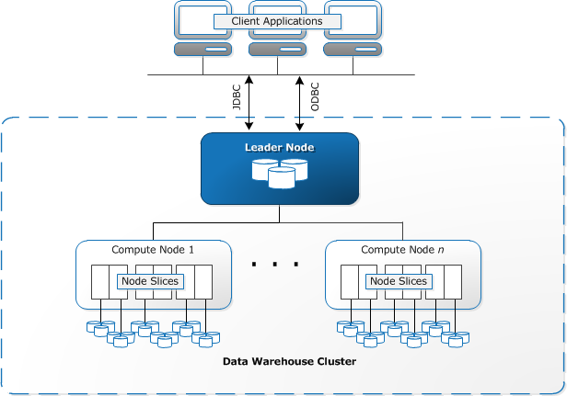
Architecture

Slide 8
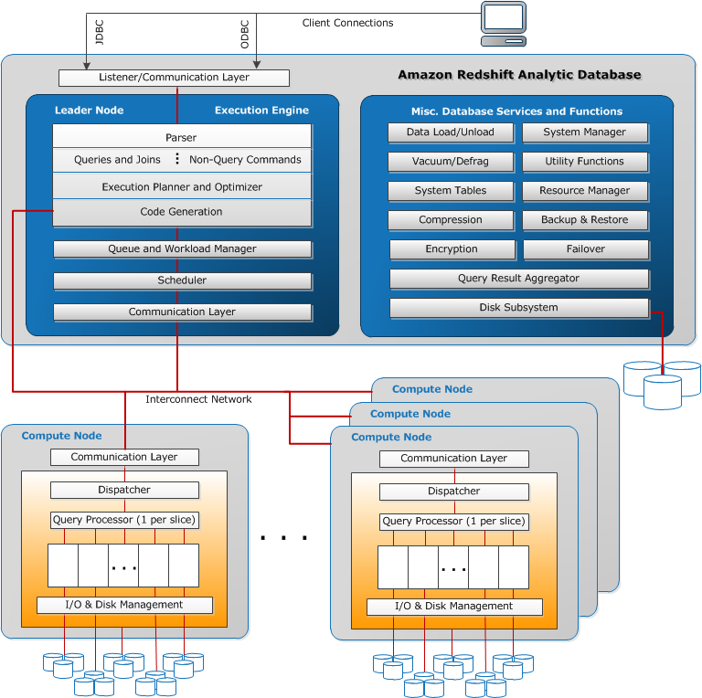
Architecture – contd.

Slide 9
Architecture – contd.
Client applications
Amazon Redshift integrates with various data loading and ETL (extract, transform, and load) tools and business intelligence (BI) reporting, data mining, and analytics tools.
Amazon Redshift is based on industry-standard PostgreSQL, so most existing SQL client applications will work with only minimal changes.
Clusters
The core infrastructure component of an Amazon Redshift data warehouse is a cluster.
A cluster is composed of one or more compute nodes. If a cluster is provisioned with two or more compute nodes, an additional leader node coordinates the compute nodes and handles external communication. Your client application interacts directly only with the leader node. The compute nodes are transparent to external applications.

Slide 10
Architecture – contd.
Leader Node
The leader node manages communications with client programs and all communication with compute nodes.
It parses and develops execution plans to carry out database operations, in particular, the series of steps necessary to obtain results for complex queries. Based on the execution plan, the leader node compiles code, distributes the compiled code to the compute nodes, and assigns a portion of the data to each compute node.
The leader node distributes SQL statements to the compute nodes only when a query references tables that are stored on the compute nodes. All other queries run exclusively on the leader node.
Amazon Redshift is designed to implement certain SQL functions only on the leader node. A query that uses any of these functions will return an error if it references tables that reside on the compute nodes.

Slide 11
Architecture – contd.
Compute Nodes
The leader node compiles code for individual elements of the execution plan and assigns the code to individual compute nodes. The compute nodes execute the compiled code and send intermediate results back to the leader node for final aggregation.
Each compute node has its own dedicated CPU, memory, and attached disk storage, which are determined by the node type. As your workload grows, you can increase the compute capacity and storage capacity of a cluster by increasing the number of nodes, upgrading the node type, or both.
Amazon Redshift provides two node types; dense storage nodes and dense compute nodes. Each node provides two storage choices. You can start with a single 160 GB node and scale up to multiple 16 TB nodes to support a petabyte of data or more.

Slide 12
Architecture – contd.
Node slices
A compute node is partitioned into slices. Each slice is allocated a portion of the node's memory and disk space, where it processes a portion of the workload assigned to the node.
The leader node manages distributing data to the slices and apportions the workload for any queries or other database operations to the slices. The slices then work in parallel to complete the operation.
The number of slices per node is determined by the node size of the cluster.
When you create a table, you can optionally specify one column as the distribution key. When the table is loaded with data, the rows are distributed to the node slices according to the distribution key that is defined for a table. Choosing a good distribution key enables Amazon Redshift to use parallel processing to load data and execute queries efficiently.

Slide 13
Cluster Management
Single Node (160 GB)
Multi-Node
Leader Node – manages client connection and receives queries
Compute Node – store data, perform queries and computation (Max. 128 Compute Nodes)
Node Type
Dense Storage – enables you to create very large data warehouses using hard disk drives (HDDs) for a very low price.
Dense Compute – enables you to create high-performance data warehouses using fast CPUs, large amounts of RAM, and solid-state disks (SSDs).

Slide 14
Cluster Instance types
Dense Storage Types
Node Size | vCPU | RAM (GiB) | Slices Per Node | Storage Per Node | Node Range | Total Capacity
ds2.xlarge | 4 | 13 | 2 | 2 TB HDD | 1–32 | 64 TB
ds2.8xlarge | 36 | 244 | 16 | 16 TB HDD | 2–128 | 2 PB
Dense Compute Types
Node Size | vCPU | RAM (GiB) | Slices Per Node | Storage Per Node | Node Range | Total Capacity
dc1.large | 2 | 15 | 2 | 160 GB SSD | 1–32 | 5.12 TB
dc1.8xlarge | 32 | 244 | 32 | 2.56 TB SSD | 2–128 | 326 TB
dc2.large | 2 | 15.25 | 2 | 160 GB NVMe-SSD | 1–32 | 5.12 TB
dc2.8xlarge | 32 | 244 | 16 | 2.56 TB NVMe-SSD | 2–128 | 326 TB

Slide 15
Data Definition Language
Create a Database
Database is where you will actually create tables, load data, and run queries. A single cluster can host multiple databases. For example, you can have a TICKIT database and an ORDERS database on the same cluster.
For example, to create a database named tickit, issue the following command:
create database tickit;

Slide 16
Data Definition Language – contd.
Create a Database User
Use the CREATE USER command to create a new database user. When you create a new user, you specify the name of the new user and a password. A password is required. It must have between 8 and 64 characters, and it must include at least one uppercase letter, one lowercase letter, and one numeral.
For example, to create a user named GUEST with password ABCd4321, issue the following command:
create user guest password 'ABCd4321';

Slide 17
Data Definition Language – contd.
Create a Database Table
After you create your new database, you create tables to hold your database data. You specify any column information for the table when you create the table.
For example, to create a table named testtable with a single column named testcol for an integer data type, issue the following command:
create table testtable (testcol int);
The PG_TABLE_DEF system table contains information about all the tables in the cluster. To verify the result, issue the following SELECT command to query the PG_TABLE_DEF system table.
select * from pg_table_def where tablename = 'testtable';

Slide 18
Data Definition Language – contd.
Insert Data Rows into a Table
After you create a table, you can insert rows of data into that table.
The INSERT command inserts individual rows into a database table. For standard bulk loads, use the COPY command.
For example, to insert a value of 100 into the testtable table (which contains a single column), issue the following command:
insert into testtable values (100);

Slide 19
Data Definition Language – contd.
Select Data from a Table
After you create a table and populate it with data, use a SELECT statement to display the data contained in the table.
The SELECT * statement returns all the column names and row values for all of the data in a table and is a good way to verify that recently added data was correctly inserted into the table.
To view the data that you entered in the testtable table, issue the following command:
select * from testtable;

Slide 20
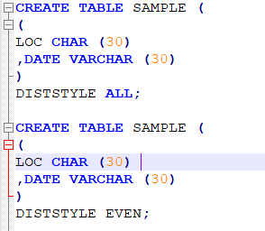
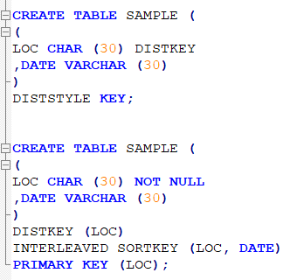
Data Definition Language – contd.

Slide 21
Best Practices
Choose the Best Distribution Style
Choose the Best Sort Key
Use Automatic Compression
Define Constraints
Use the Smallest Possible Column Size
Using Date/Time Data Types for Date Columns

Slide 22
Distribution Style
Choosing a Data Distribution Style
When you load data into a table, Amazon Redshift distributes the rows of the table to each of the compute nodes according to the table's distribution style.
When you run a query, the query optimizer redistributes the rows to the compute nodes as needed to perform any joins and aggregations.
The goal in selecting a table distribution style is to minimize the impact of the redistribution step by locating the data where it needs to be before the query is executed.
When you create a table, you can designate one of four distribution styles; AUTO, EVEN, KEY, or ALL.
If you don't specify a distribution style, Amazon Redshift uses AUTO distribution.

Slide 23
Distribution Style – contd.
KEY distribution
The rows are distributed according to the values in one column.
The leader node places matching values on the same node slice.
If you distribute a pair of tables on the joining keys, the leader node collocates the rows on the slices according to the values in the joining columns so that matching values from the common columns are physically stored together.
EVEN distribution
The leader node distributes the rows across the slices in a round-robin fashion, regardless of the values in any particular column.
EVEN distribution is appropriate when a table does not participate in joins or when there is not a clear choice between KEY distribution and ALL distribution.

Slide 24
Distribution Style – contd.
ALL distribution
A copy of the entire table is distributed to every node.
Where EVEN distribution or KEY distribution place only a portion of a table's rows on each node, ALL distribution ensures that every row is collocated for every join that the table participates in.
ALL distribution multiplies the storage required by the number of nodes in the cluster, and so it takes much longer to load, update, or insert data into multiple tables.
ALL distribution is appropriate only for relatively slow moving tables; that is, tables that are not updated frequently or extensively.
Small dimension tables do not benefit significantly from ALL distribution, because the cost of redistribution is low.

Slide 25
Distribution Style – contd.
AUTO distribution
With AUTO distribution, Amazon Redshift assigns an optimal distribution style based on the size of the table data.
For example, Amazon Redshift initially assigns ALL distribution to a small table, then changes to EVEN distribution when the table grows larger.
When a table is changed from ALL to EVEN distribution, storage utilization might change slightly. The change in distribution occurs in the background, in a few seconds.
Amazon Redshift never changes the distribution style from EVEN to ALL. To view the distribution style applied to a table, query the PG_CLASS_INFO system catalog view.
If you don't specify a distribution style with the CREATE TABLE statement, Amazon Redshift applies AUTO distribution.

Slide 26
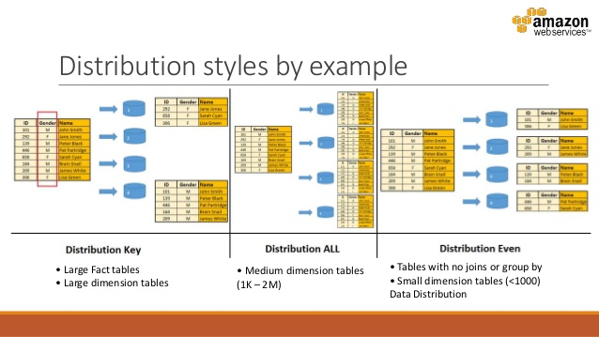
Distribution Style – contd.

Slide 27
Sort Key
Choosing Sort Key
When you create a table, you can define one or more of its columns as sort keys.
When data is initially loaded into the empty table, the rows are stored on disk in sorted order. Information about sort key columns is passed to the query planner, and the planner uses this information to construct plans that exploit the way that the data is sorted.
Sorting enables efficient handling of range-restricted predicates. Amazon Redshift stores columnar data in 1 MB disk blocks. The min and max values for each block are stored as part of the metadata. If query uses a range-restricted predicate, the query processor can use the min and max values to rapidly skip over large numbers of blocks during table scans.
You can specify either a compound or interleaved sort key.

Slide 28
Sort Key – contd.
Compound Sort Key
A compound key is made up of all of the columns listed in the sort key definition, in the order they are listed.
A compound sort key is most useful when a query's filter applies conditions, such as filters and joins, that use a prefix of the sort keys.
The performance benefits of compound sorting decrease when queries depend only on secondary sort columns, without referencing the primary columns. COMPOUND is the default sort type.
Compound sort keys might speed up joins, GROUP BY and ORDER BY operations, and window functions that use PARTITION BY and ORDER BY. For example, a merge join, which is often faster than a hash join, is feasible when the data is distributed and presorted on the joining columns. Compound sort keys also help improve compression.

Slide 29
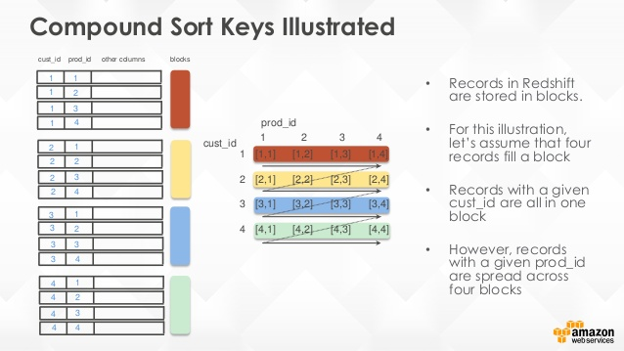
Sort Key – contd.

Slide 30
Sort Key – contd.
Interleaved Sort Key
An interleaved sort gives equal weight to each column, or subset of columns, in the sort key. If multiple queries use different columns for filters, then you can often improve performance for those queries by using an interleaved sort style.
When a query uses restrictive predicates on secondary sort columns, interleaved sorting significantly improves query performance as compared to compound sorting.
An interleaved sort is more effective with large tables. Sorting is applied on each slice, so an interleaved sort is most effective when a table is large enough to require multiple 1 MB blocks per slice and the query processor is able to skip a significant proportion of the blocks using restrictive predicates.
Don’t use an interleaved sort key on columns with monotonically increasing attributes, such as identity columns, dates, or timestamps.

Slide 31
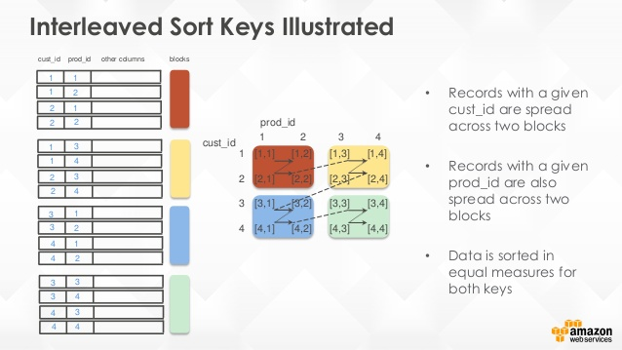
Sort Key – contd.

Slide 32
Compression Encoding
A compression encoding specifies the type of compression that is applied to a column of data values as rows are added to a table.
If no compression is specified in a CREATE TABLE or ALTER TABLE statement, Amazon Redshift automatically assigns compression encoding as follows:
Columns that are defined as sort keys are assigned RAW compression.
Columns that are defined as BOOLEAN, REAL, or DOUBLE PRECISION data types are assigned RAW compression.
Columns that are defined as SMALLINT, INTEGER, BIGINT, DECIMAL, CHAR, VARCHAR, DATE, TIMESTAMP, or TIMESTAMPTZ data types are assigned LZO compression.

Slide 33
Compression Encoding – contd.
Encoding type | Keyword in CREATE TABLE and ALTER TABLE | Data types
Raw (no compression) | RAW | All
Byte dictionary | BYTEDICT | All except BOOLEAN
Delta | DELTA DELTA32K | SMALLINT, INT, BIGINT, DATE, TIMESTAMP, DECIMAL INT, BIGINT, DATE, TIMESTAMP, DECIMAL
LZO | LZO | All except BOOLEAN, REAL, and DOUBLE PRECISION
Mostlyn | MOSTLY8 MOSTLY16 MOSTLY32 | SMALLINT, INT, BIGINT, DECIMAL INT, BIGINT, DECIMAL BIGINT, DECIMAL
Run-length | RUNLENGTH | All
Text | TEXT255 TEXT32K | VARCHAR only VARCHAR only
Zstandard | ZSTD | All

Slide 34
Vacuum and Analyze
Whenever you add, delete, or modify a significant number of rows, you should run a VACUUM command and then an ANALYZE command.
A vacuum recovers the space from deleted rows and restores the sort order.
The ANALYZE command updates the statistics metadata, which enables the query optimizer to generate more accurate query plans.
To vacuum and analyze the database, execute the following commands.
vacuum;
analyze;

Slide 35
Data Loading and Unloading
Using a COPY Command to Load Data
The COPY command leverages the Amazon Redshift massively parallel processing (MPP) architecture to read and load data in parallel from files on Amazon S3, from a DynamoDB table, or from text output from one or more remote hosts.
You can specify the files to be loaded by using an Amazon S3 object prefix or by using a manifest file.
The syntax to specify the files to be loaded by using a prefix or manifest is as follows:
copy <table_name> from 's3://<bucket_name>/<object_prefix>'
authorization;
copy <table_name> from 's3://<bucket_name>/<manifest_file>'
authorization
manifest;

Slide 36
Data Loading and Unloading – contd.
Unload Data
Amazon Redshift splits the results of a select statement across a set of files, one or more files per node slice, to simplify parallel reloading of the data. Alternatively, you can specify that UNLOAD should write the results serially to one or more files by adding the PARALLEL OFF option. You can limit the size of the files in Amazon S3 by specifying the MAXFILESIZE parameter. UNLOAD automatically encrypts data files using Amazon S3 server-side encryption (SSE-S3).
For example, the following UNLOAD command sends the contents of the VENUE table to the Amazon S3 bucket s3://mybucket/tickit/unload/.
unload ('select * from venue')
to 's3://mybucket/tickit/unload/venue_'
iam_role 'arn:aws:iam::0123456789012:role/MyRedshiftRole';

Slide 37
Stored Procedure
Stored procedures are commonly used to encapsulate logic for data transformation, data validation, and business-specific logic. By combining multiple SQL steps into a stored procedure, you can reduce round trips between your applications and the database.
To create a stored procedure, use the CREATE PROCEDURE command.
To run a procedure, use the CALL command.
CREATE OR REPLACE PROCEDURE test()
AS $$
BEGIN
SELECT 1 a;
END;
$$
LANGUAGE plpgsql
;
/

